Slide 1
Addressing Crash Recovery with Persistent Memory Allocation
Advisors: Dr. Michael Spear Dr. Roberto Palmieri
Student: Nick Stone

Slide 2
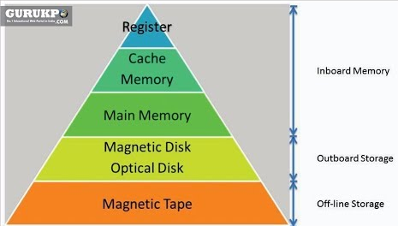
Level 3 and 4 of Memory Hierarchy
Recall that Level’s 3 and 4 of the memory hierarchy are main memory (DRAM) and secondary storage (SSD or HDD)
DRAM- Dynamic Random Access memory, Fast but volatile allows memory addressing to no longer be sequential
Secondary Storage- Hard disks are SLOW but allow for data to be preserved for long periods of time. Hard disks usually last 3-4 years

Slide 3
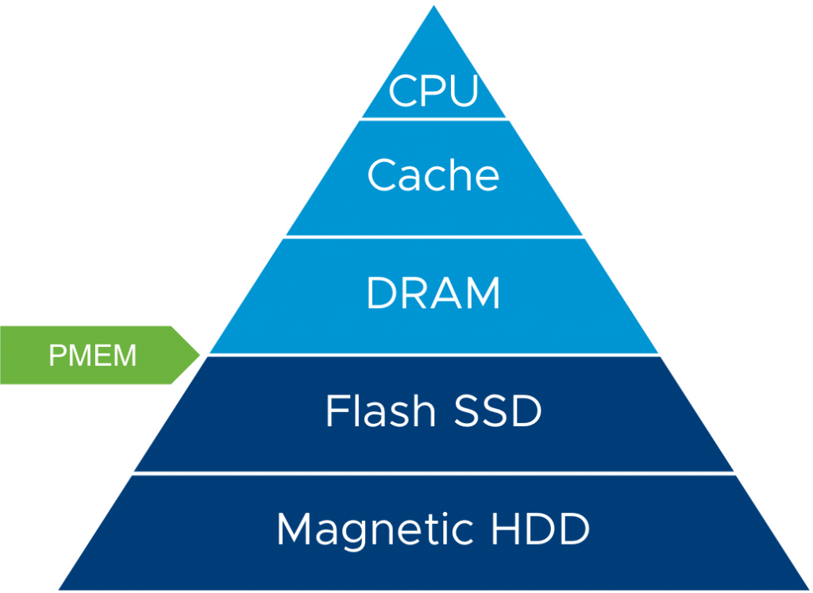
Persistent Memory
Low-level features
Byte-addressable, in the memory hierarchy
Latency = ~2x DRAM access
Write endurance = ~10⁹ to 10¹¹ stores
Near-zero idle power consumption
More dense than DRAM
Preserves its contents upon power off
*Slide Courtesy of Dr. Michael Spear*

Slide 4
Differences In DRAM and Persistent Memory
DRAM allows for random memory access which allows for a fast main memory but all data is volatile... If a power failure occurs all data in DRAM is lost.
Persistent memory is Byte addressable and is a combination of the two mediums of storage, meaning that it can be used like DRAM but has long term storage of HDD or SSD.

Slide 5

Problems with Persistent Memory
Persistent memory has write endurance… Eventually the memory cells will be destroyed.
What if a program crashes in the middle of a bulk update of NVM?
Old state may be partially updated to new state... How to recover some valid state?

Slide 6
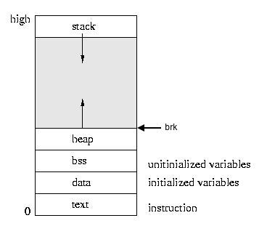
Memory Allocator
Memory allocation is the process of setting aside sections of memory in a program to be used to store variables, and instances of structures and classes.
A Memory Allocator is a program that controls when and what sections of memory are being used by the program to store data.
Memory Allocator’s also deal with freeing memory that is no longer being used by the program.

Slide 7
Overview
As discussed earlier Persistent memory is byte addressable meaning that we can create a memory allocator to allocate specific blocks of memory not just random or sequential blocks.
Furthermore the memory in each cell will persist even after a program crash or program failure
Thus an allocator can execute smart memory allocation allowing programs to easily recover all data after a crash

Slide 8
The Project
The project is then to create a memory allocator that leverages both DRAM and Persistent memory in order to create a crash recoverable memory allocator that is not excessively writing to persistent memory

Slide 9

Questions?

Slide 10
References
https://dl.acm.org/citation.cfm?id=2984019
https://www.cs.cmu.edu/~pavlo/papers/p1753-arulraj.pdf
http://www.cs.uah.edu/~rcoleman/Common/C_Reference/MemoryAlloc.html
https://www.programiz.com/c-programming/c-dynamic-memory-allocation
https://www.storagereview.com/ssd_vs_hdd
https://www.intel.com/content/www/us/en/benchmarks/server/xeon-e5-v4/xeon-e5-v4-enterprise-general-compute.html

